Slide 1
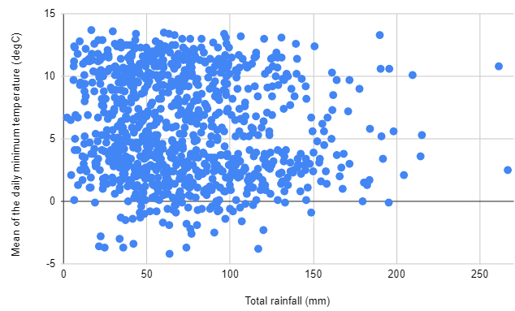
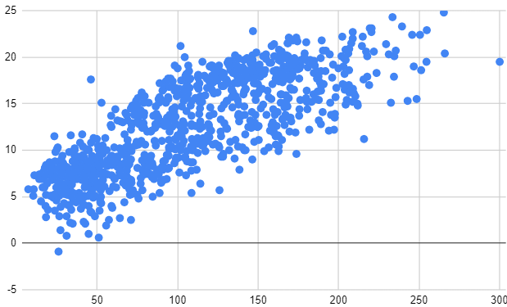
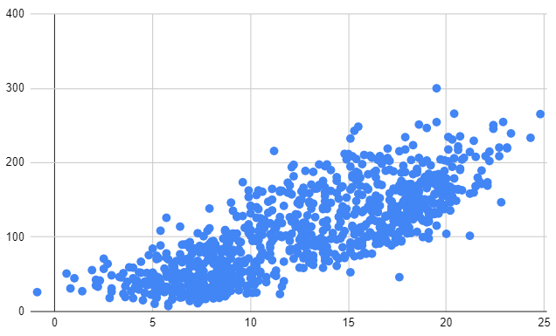
Constructing scatter graphs by utilising technology
Task A: Constructing a scatter graph using a spreadsheet
1) Access the data for this task by clicking here: Bradford weather data 🖇
Construct a scatter graph with the horizontal axis showing total rainfall and the vertical axis showing mean daily minimum temperature.
2) The scatter graphs below were plotted using the weather dataset. Access the data for this task by clicking here: Bradford weather data🖇
Plot different scatter graphs to work out which variables go on the horizontal axis in each of the graphs below.
mean maximum daily temperature (℃)
total sunshine duration (hours)
total sunshine duration (hours)
mean maximum daily temperature
Google Sheets is a trademark of Google LLC and this content is not endorsed by or affiliated with Google in any way.

Slide 2
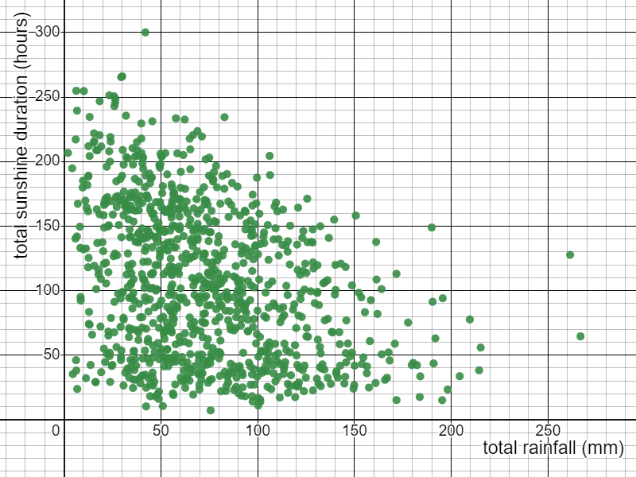
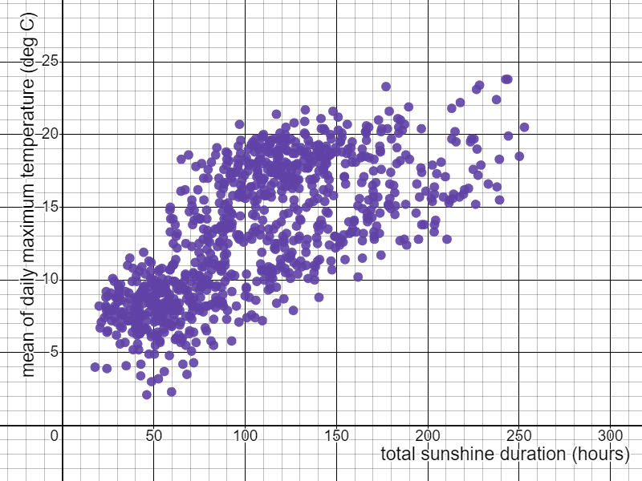
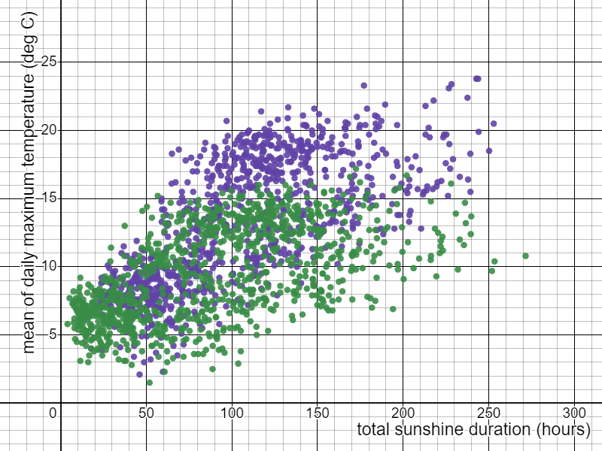
Constructing scatter graphs by utilising technology
Task B: Constructing a scatter graph using Desmos
1) Access the data for this task by clicking here: UK weather data🖇
Construct a scatter graph for Bradford’s data, with the horizontal axis showing total rainfall and the vertical axis showing total sunshine duration.
2) Access the data for this task by clicking here: UK weather data🖇
a) Construct a scatter graph for Armargh’s data, with the horizontal axis showing total sunshine duration and the vertical axis showing the mean of the daily maximum temperature.
b) On the same graph plot the same data for Lerwick and make sure the points are a different colour to Armargh’s data.
c) Which town tends to get the warmest?
Amargh
Mathematics in Education and Industry
Google Sheets is a trademark of Google LLC and this content is not endorsed by or affiliated with Google in any way.
v2.2

